Slide 1

Ciência de Dados Aplicado à Ciência de Cidades
PPGIA
Hygor P. M. Melo
hygor.piaget@gmail.com

Slide 2
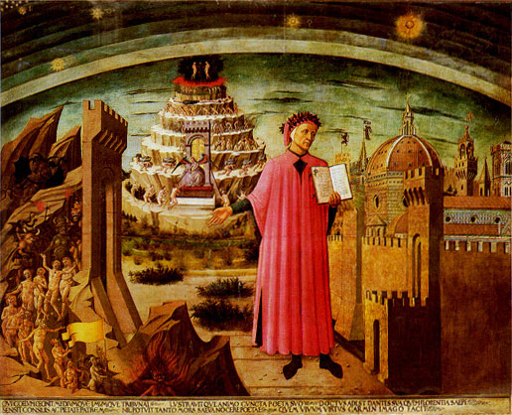
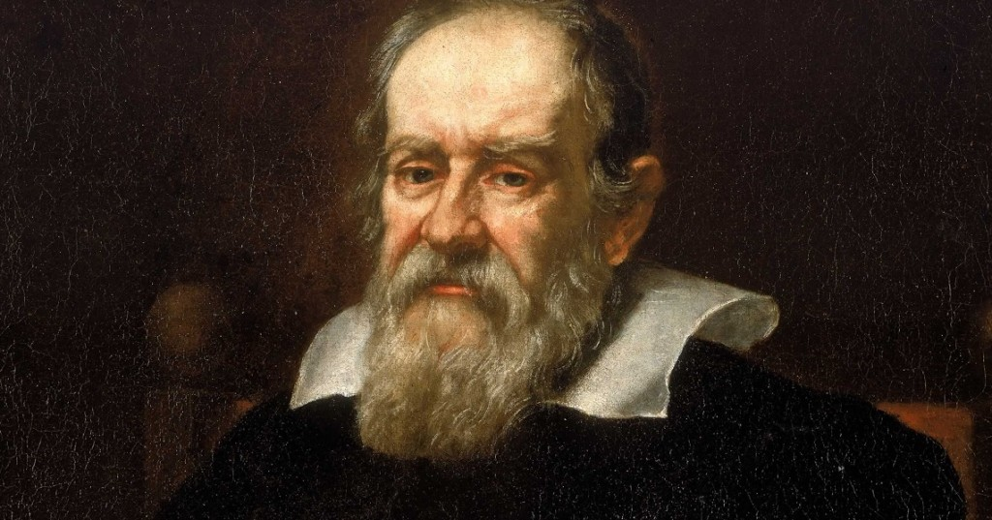
On the Shape, Location, and Size of Dante's Inferno
According to Dante, the centre of the roof lay in Jerusalem:
  "Already the Sun was joined to the horizon / Whose meridian circle covers / Jerusalem with its highest point"

Slide 3
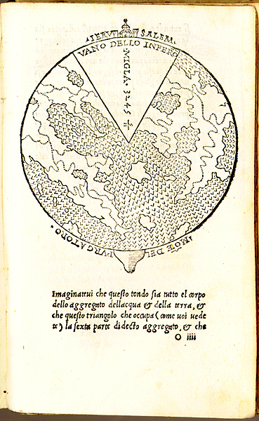
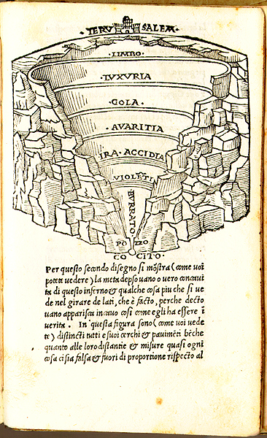
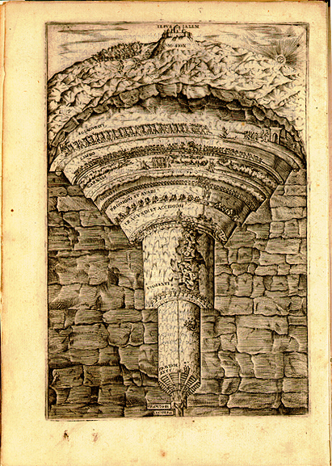

Slide 4
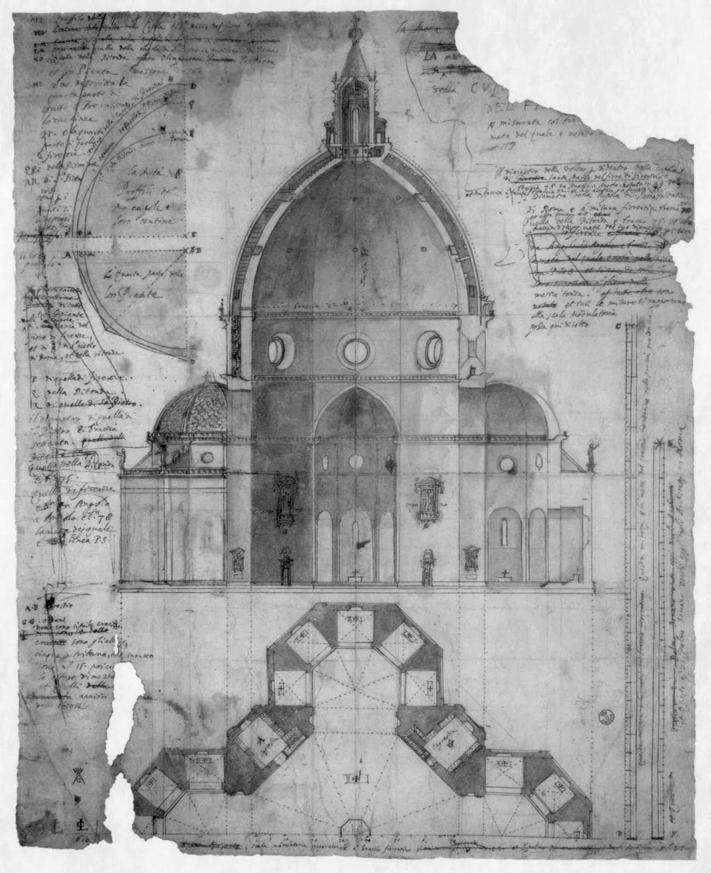
On the Shape, Location, and Size of Dante's Inferno
Galileo tried to estimate the width of the hell's vaulted roof.
Galileo interpreted that the diameter of hell's circle must be equal to the radius of the Earth.
How thick is the dome so it does not collapse?
The dome of Florence cathedral has 45m of diameter and is 3m thick…
So the thickness of the hell´s roof must be ~600km!!

Slide 5
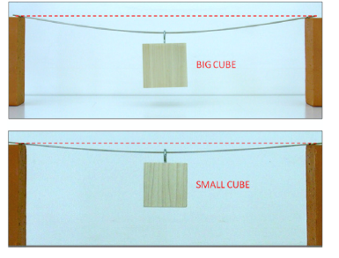
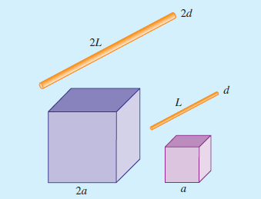

Slide 6
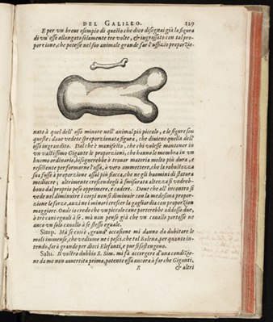
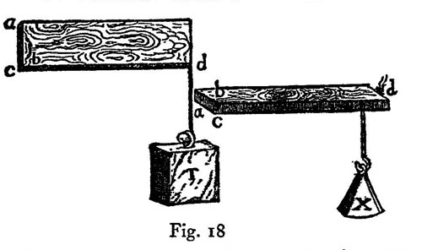
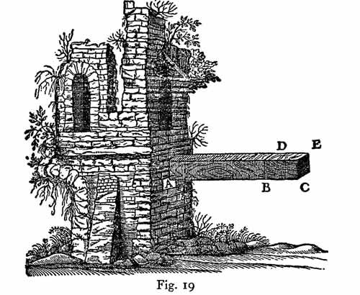
Discorsi e dimostrazioni matematiche intorno a due nuove scienze (1638).

Slide 7
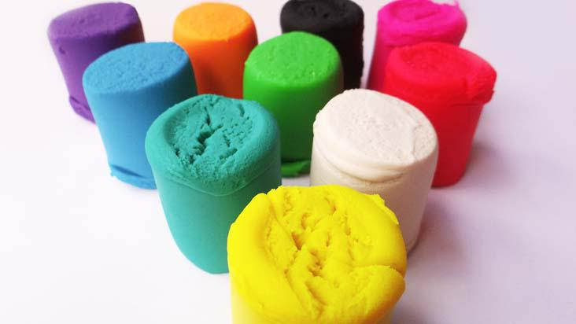
Scaling Laws
DIY

Slide 8


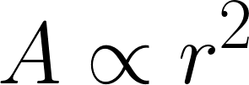
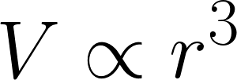

Slide 9
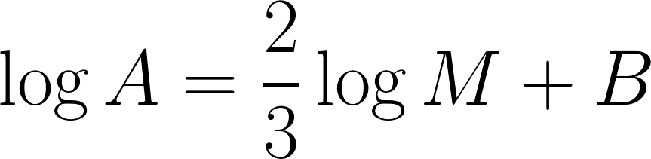
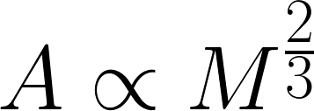

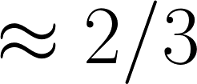


Slide 10


Slide 11

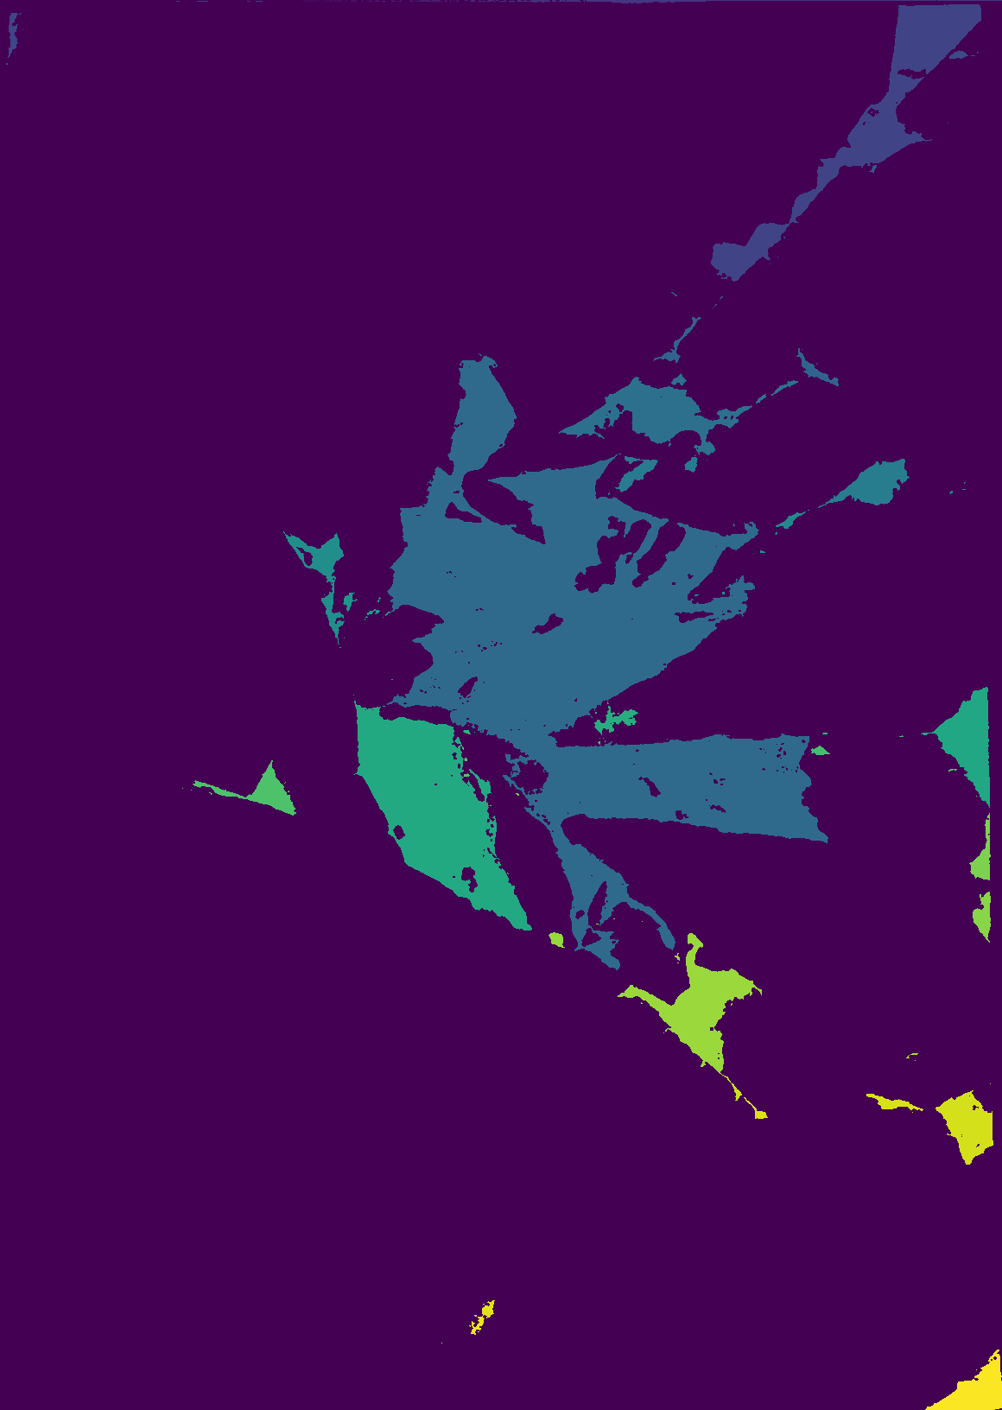

Slide 12
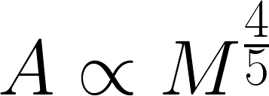
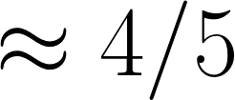

Slide 13


Bruno Mota - UFRJ

Slide 14
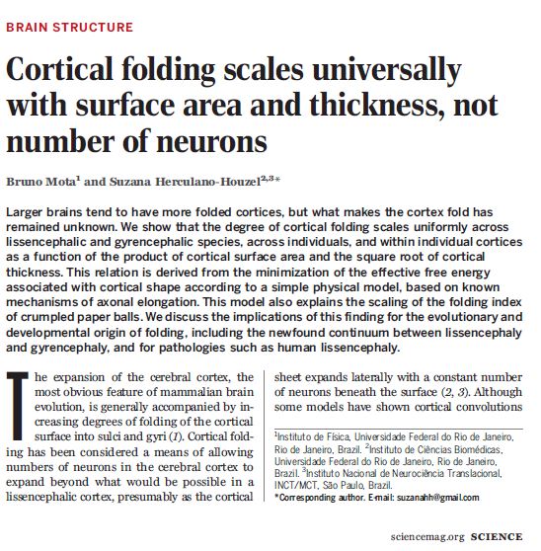

Slide 15
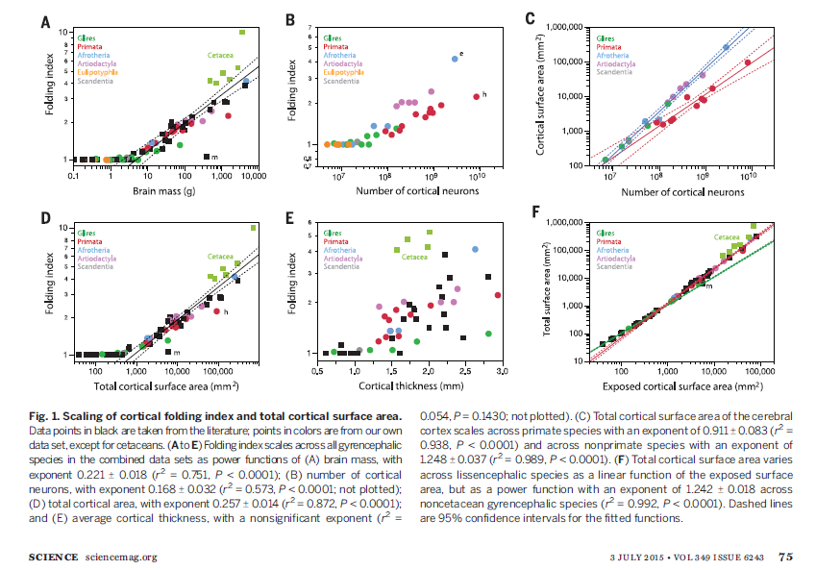

Slide 16

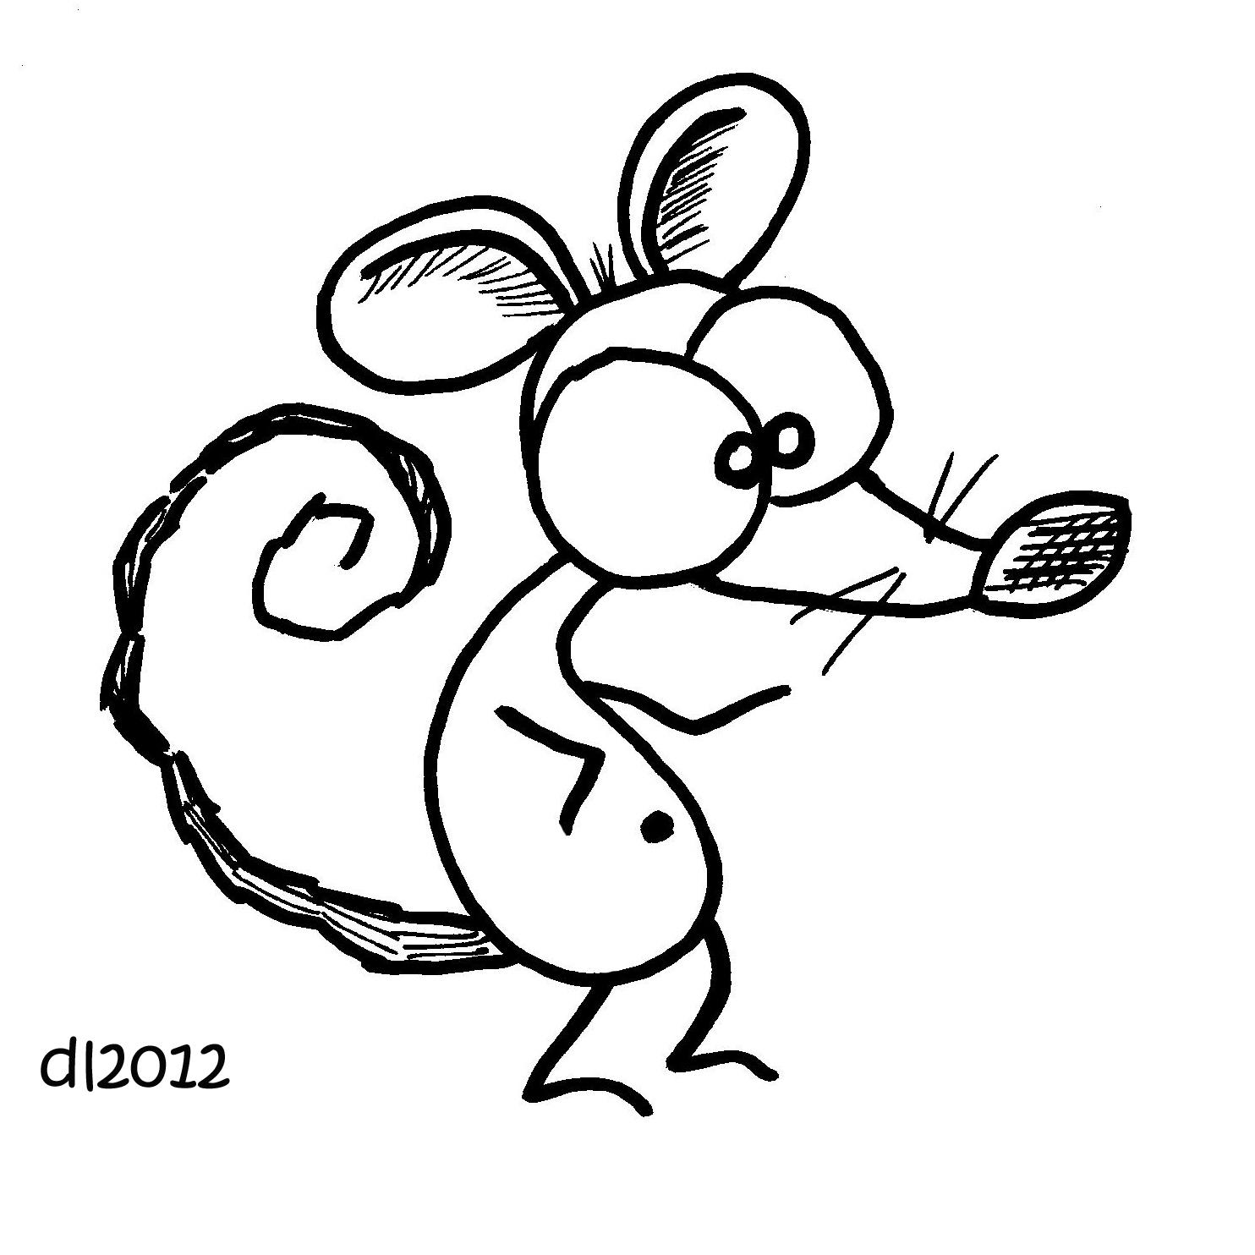

Slide 17
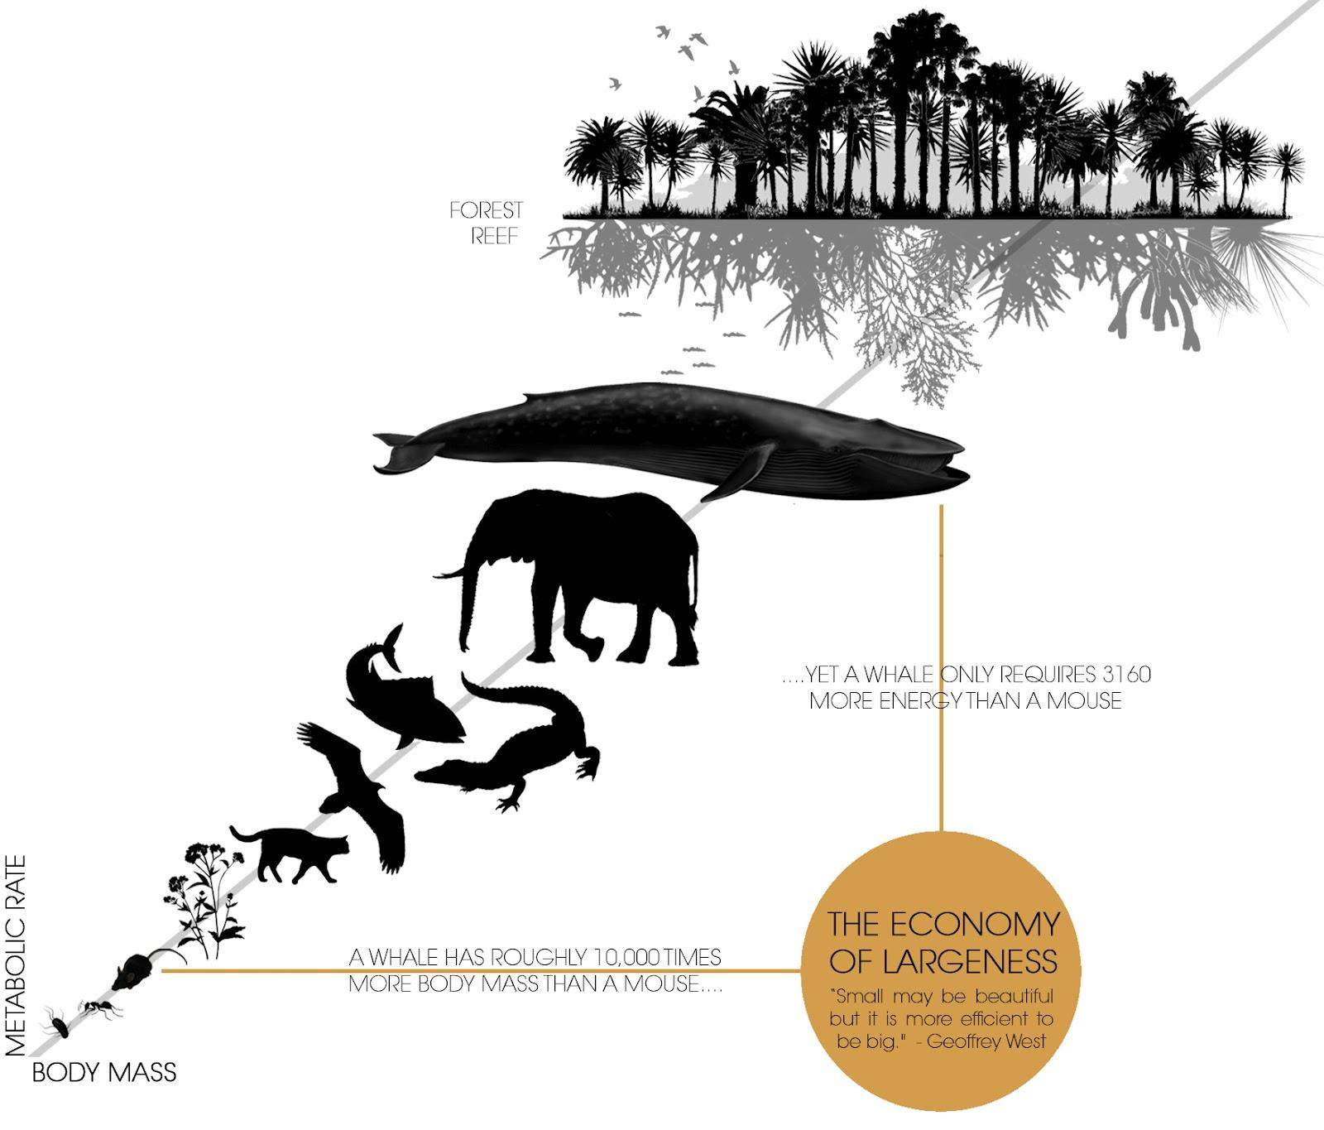
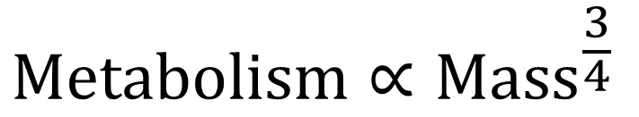
Despite this it only needs 3160 times more energy.
Log(Metabolism)
Whale has 10 thousand times more mass than a mouse.
Kleiber M (October 1947). "Body size and metabolic rate". Physiological Reviews. 27 (4): 511–41.
Log(Mass)

Slide 18

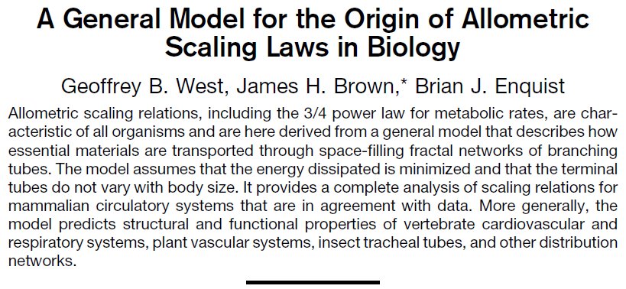
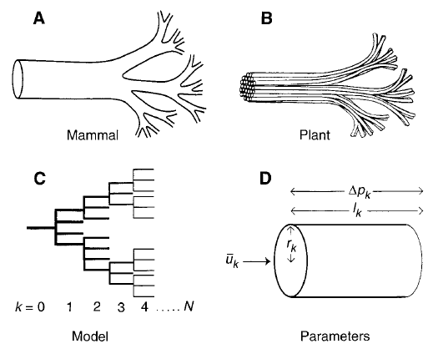

Slide 19
We still debating about the ¾ law!!
Dodds, Peter Sheridan, Daniel H. Rothman, and Joshua S. Weitz. "Re-examination of the “3/4-law” of metabolism." Journal of Theoretical Biology 209.1 (2001): 9-27.
Kozłowski, Jan, and M. Konarzewski. "Is West, Brown and Enquist's model of allometric scaling mathematically correct and biologically relevant?." Functional Ecology 18.2 (2004): 283-289.
  Brown, James H., Geoffrey B. West, and B. J. Enquist. "Yes, West, Brown and Enquist's model of allometric scaling is both mathematically correct and biologically relevant." Functional Ecology 19.4 (2005): 735-738.
  Kozłowski, Jan, and Marek Konarzewski. "West, Brown and Enquist's model of allometric scaling again: the same questions remain." Functional Ecology 19.4 (2005): 739-743.
Nakaya, Fumio, Yasunori Saito, and Tatsuo Motokawa. "Experimental allometry: effect of size manipulation on metabolic rate of colonial ascidians." Proceedings of the Royal Society B: Biological Sciences 272.1575 (2005): 1963-1969.

Slide 20


Slide 21
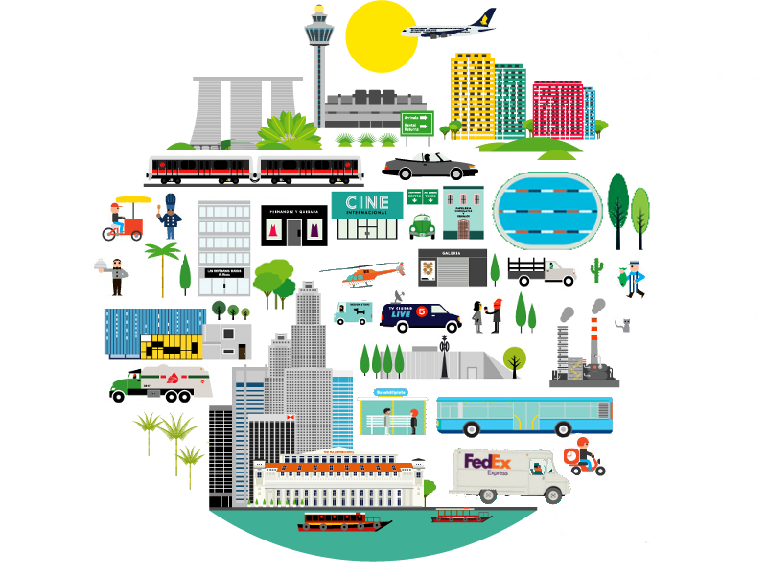

Slide 22
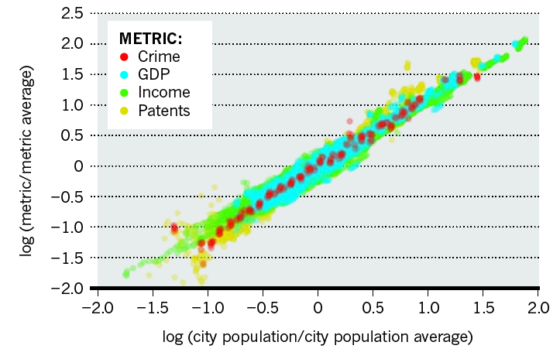
Bettencourt, Luís MA, et al. "Growth, innovation, scaling, and the pace of life in cities."
PNAS 104.17 (2007): 7301-7306.

Slide 23

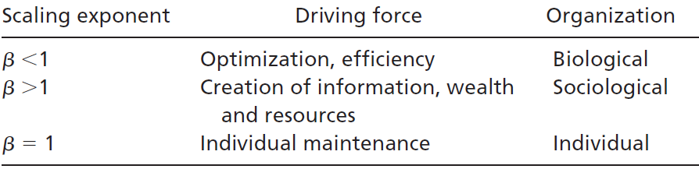

Slide 24



Scaling of Health Indicators

Slide 25
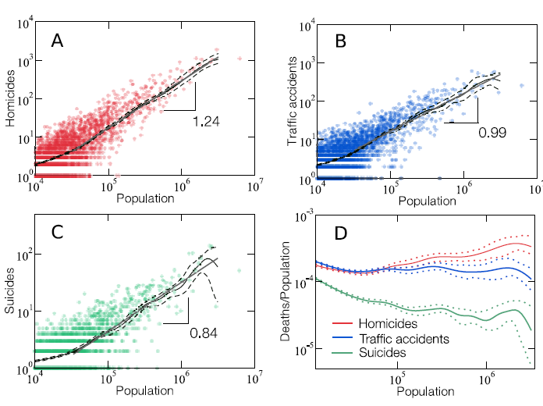
Melo, Hygor Piaget M., et al. "Statistical signs of social influence on suicides." Scientific reports 4.1 (2014): 1-6.

Slide 26
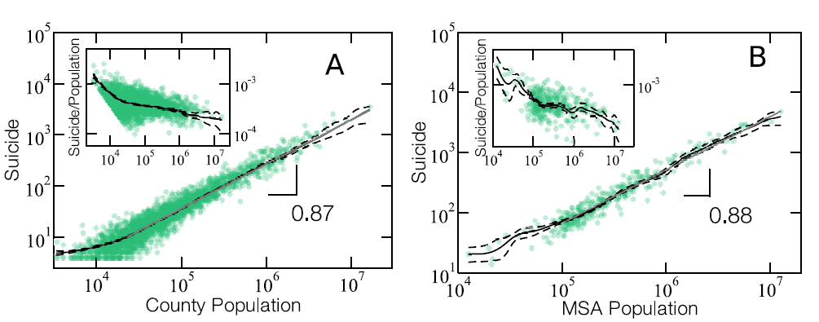
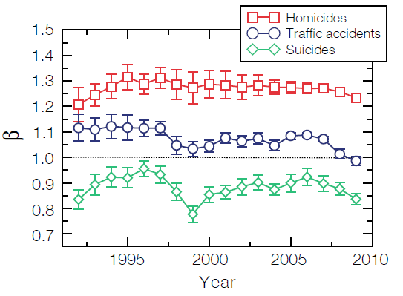
Melo, Hygor Piaget M., et al. "Statistical signs of social influence on suicides." Scientific reports 4.1 (2014): 1-6.

Slide 27

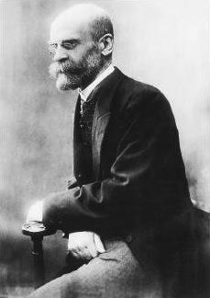
But why?
Traffic accidents are random events in which the social network must have little influence.
Homicides and Suicides are events that undergo the influence of social structure in the form of a complex network.
Émile Durkheim

Slide 28
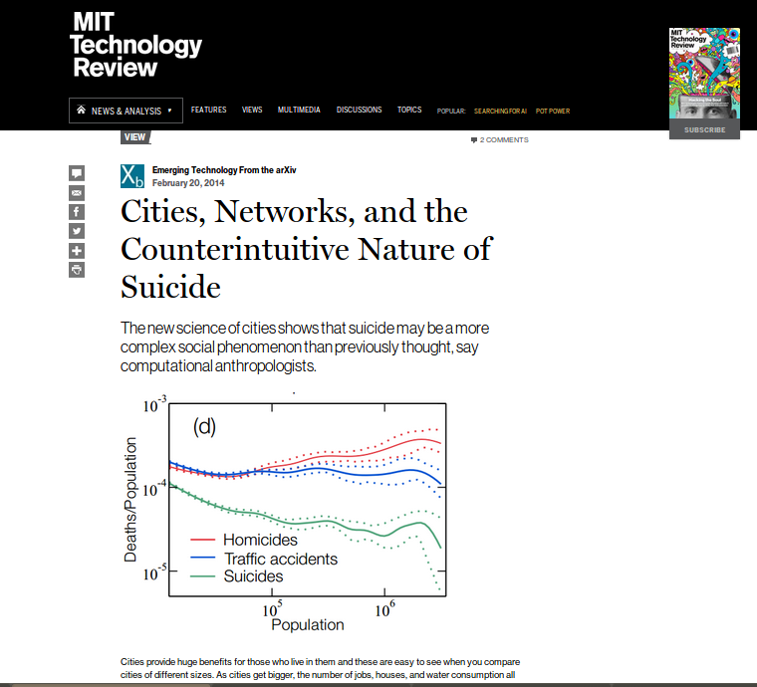

Slide 29
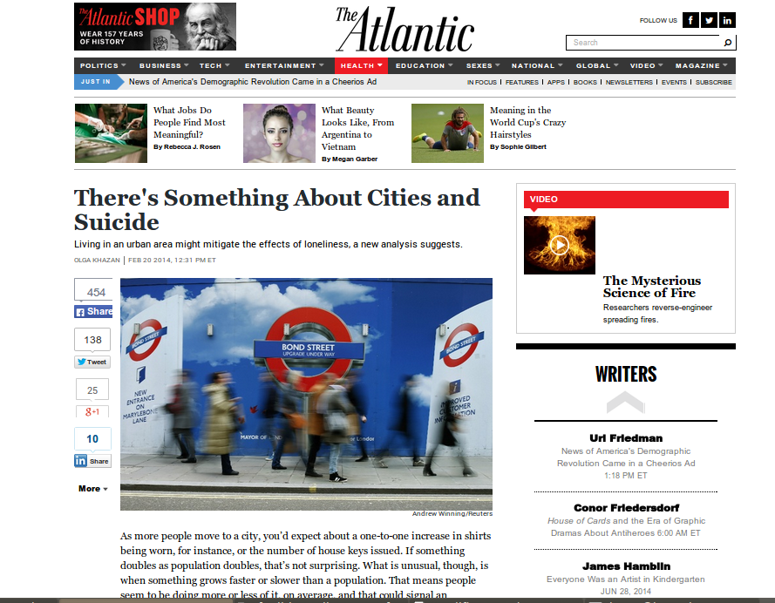

Slide 30


Slide 31

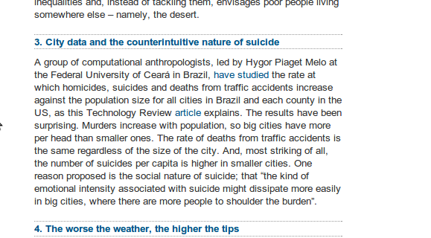

Slide 32
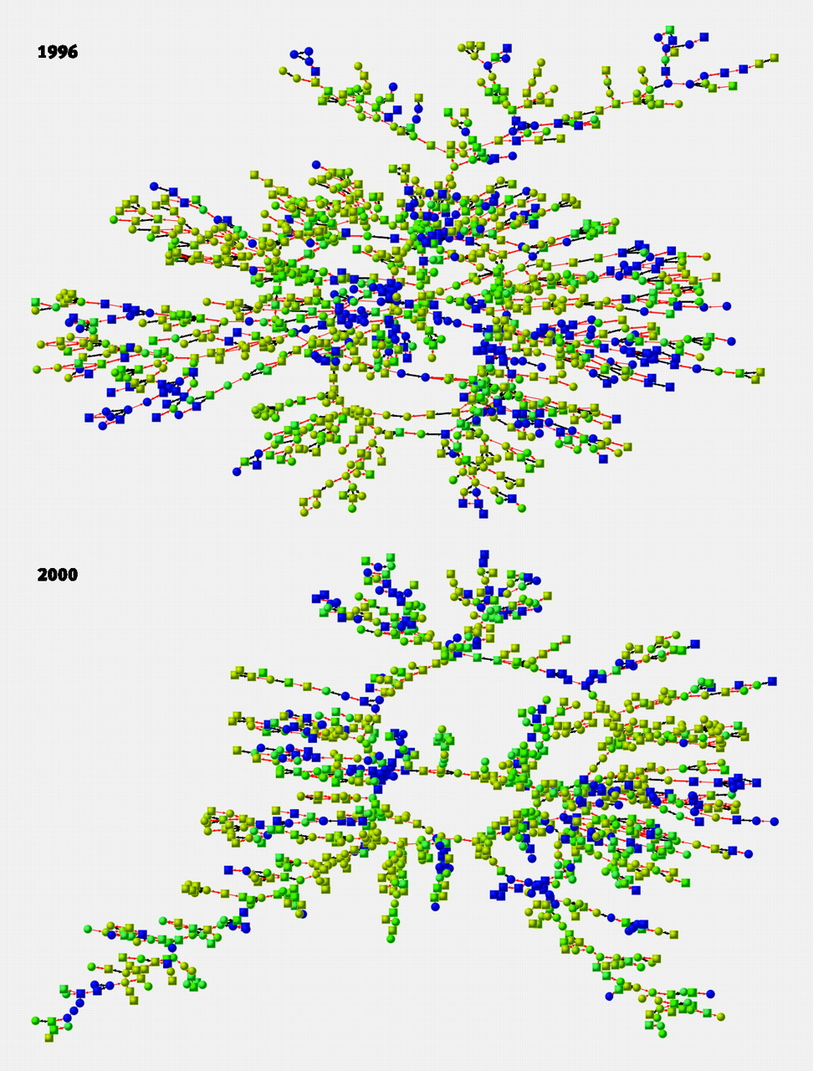
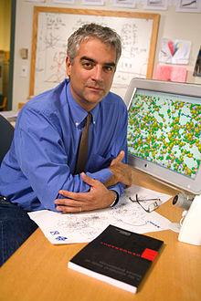
Possible origin for
non-linearity in suicides
1996
Fowler, James H., and Nicholas A. Christakis. "Dynamic spread of happiness in a large social network: longitudinal analysis over 20 years in the Framingham Heart Study." Bmj 337 (2008).
Rosenquist, J. Niels, James H. Fowler, and Nicholas A. Christakis. "Social network determinants of depression." Molecular psychiatry 16.3 (2011): 273-281.
2000
Hill, Alison L., et al. "Emotions as infectious diseases in a large social network: the SISa model." Proceedings of the Royal Society B: Biological Sciences 277.1701 (2010): 3827-3835.
Nicholas A. Christakis

Slide 33
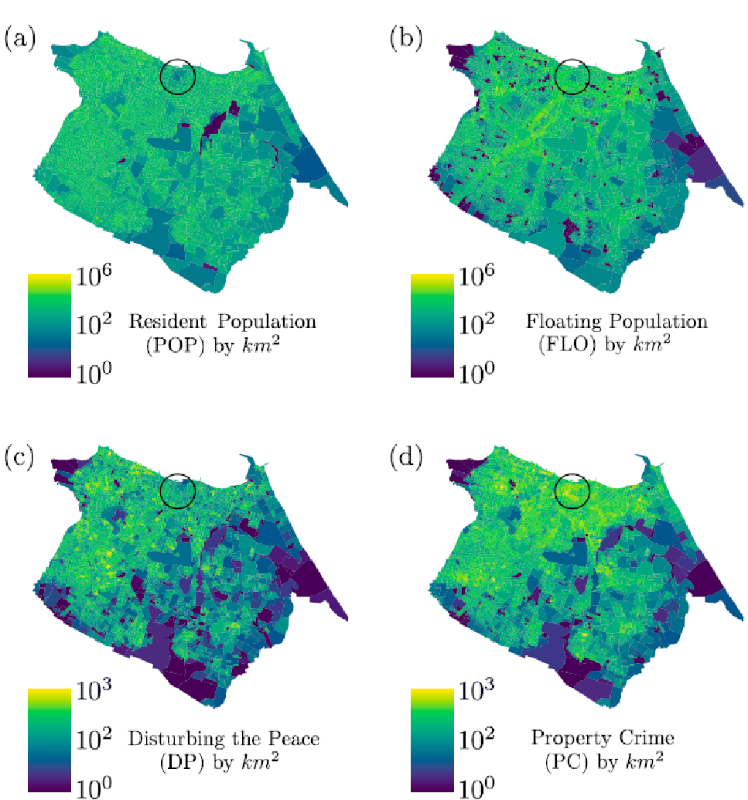
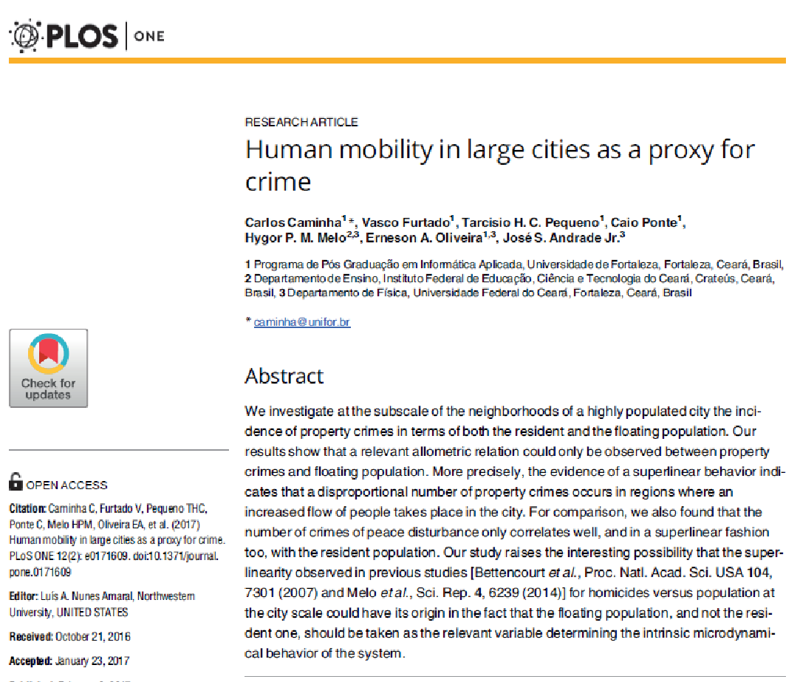
Allometric scaling within a city

Slide 34
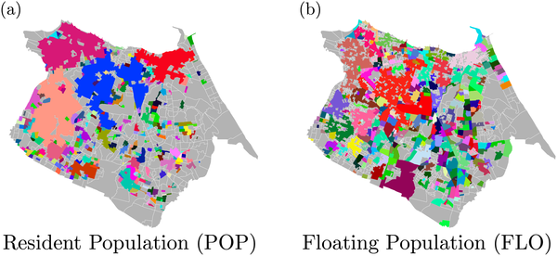
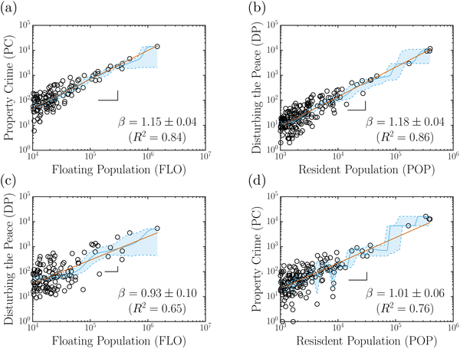
Caminha C, Furtado V, Pequeno THC, Ponte C, Melo HPM, et al. (2017) Human mobility in large cities as a proxy for crime. PLOS ONE 12(2): e0171609.

Slide 35
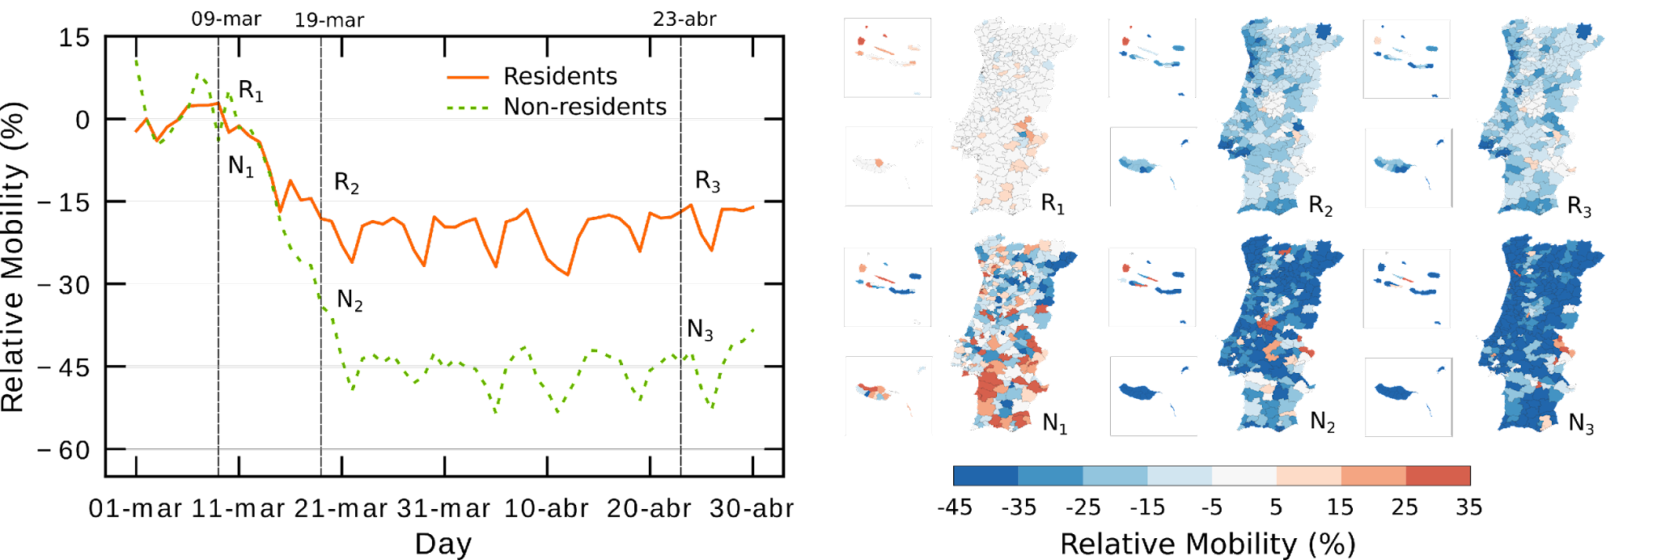
Scaling in mobility: Lockdown in Portugal
Melo, Hygor Piaget M., et al. "Heterogeneous impact of a lockdown on inter-municipality mobility." Physical Review Research 3.1 (2021): 013032.

Slide 36
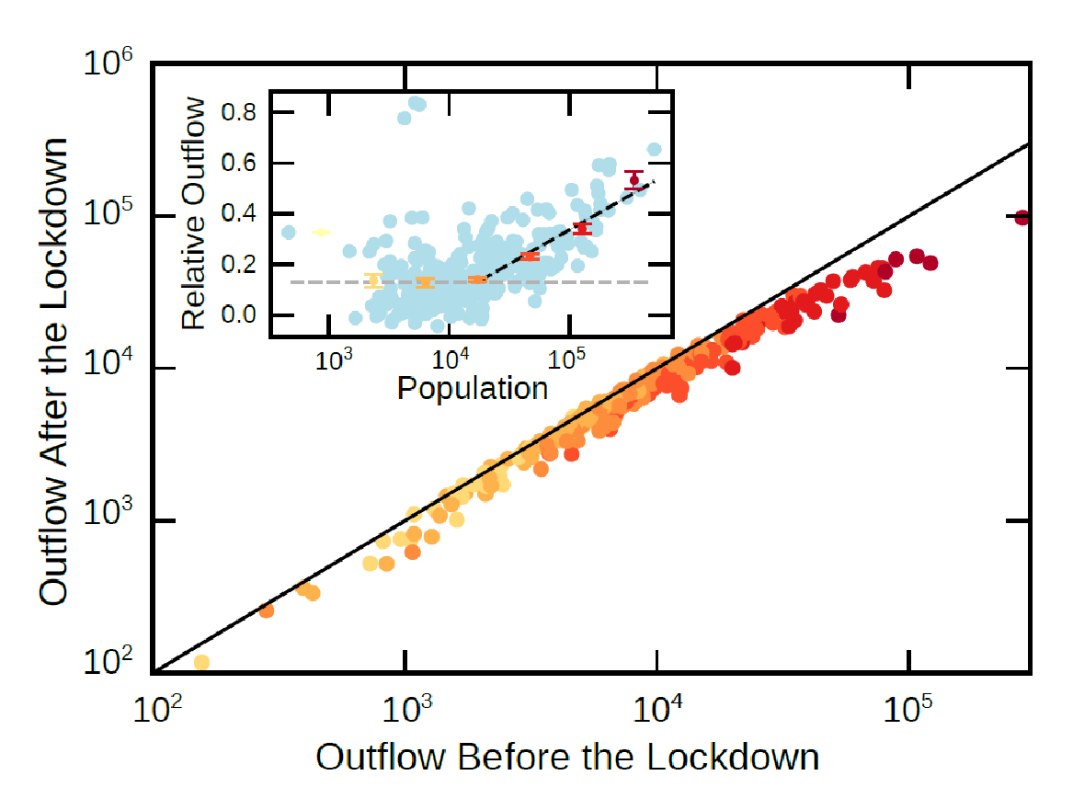
Heterogeneous response
Melo, Hygor PM, et al. "Heterogeneous impact of a lockdown on inter-municipality mobility." Physical Review Research 3.1 (2021): 013032.

Slide 37
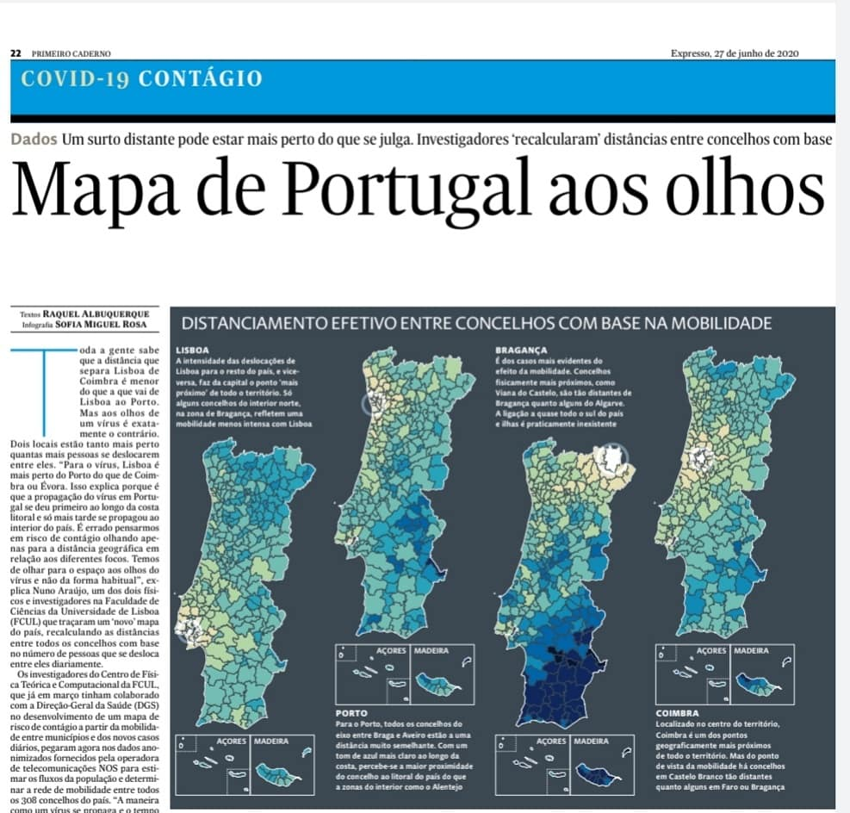
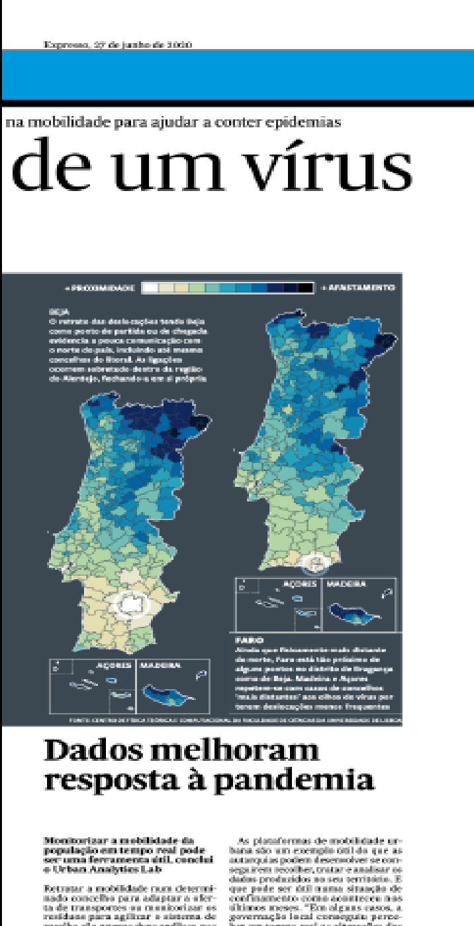
Why this is important?

Slide 38
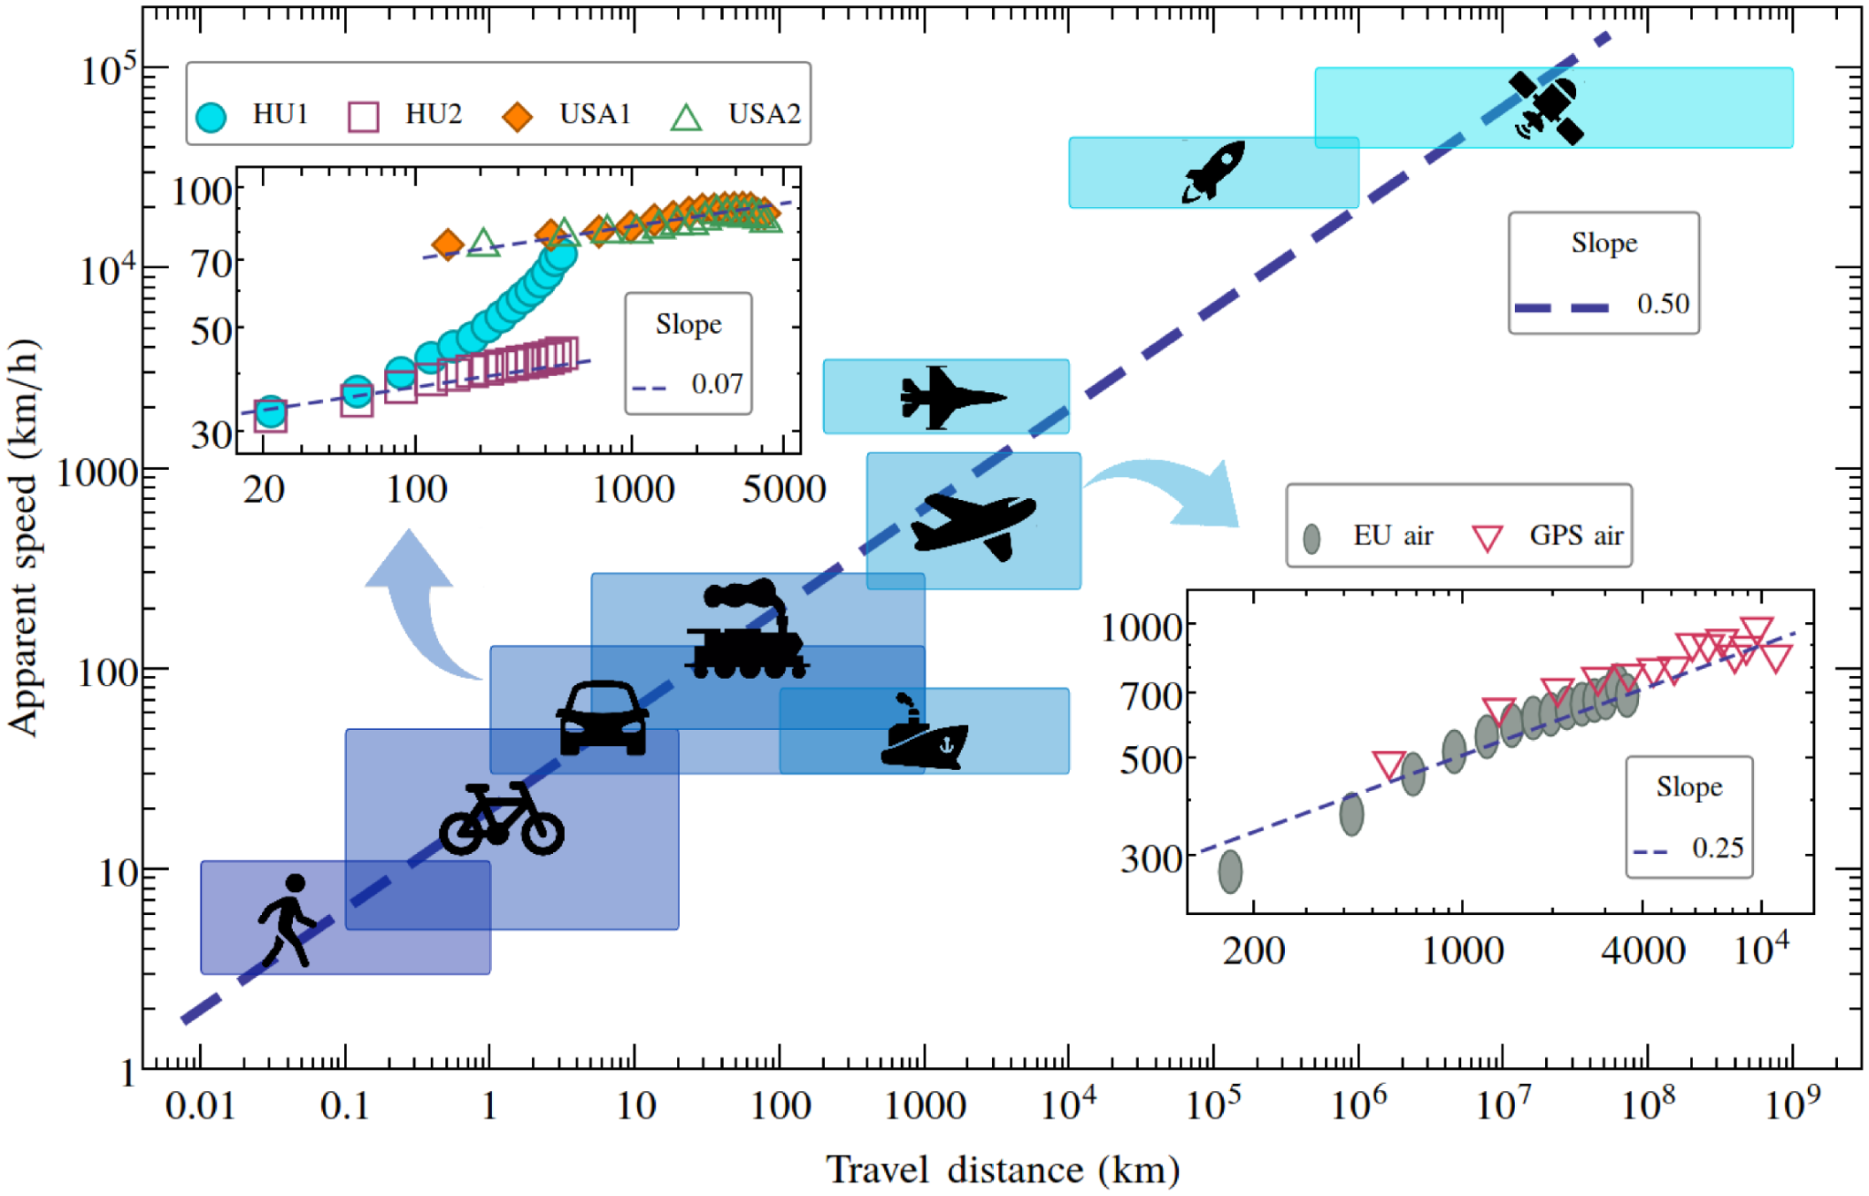


Scaling in mobility
What is the relation between distance and travel time?
?
Varga, Levente, et al. "Further we travel the faster we go." PloS one 11.2 (2016): e0148913.

Slide 39
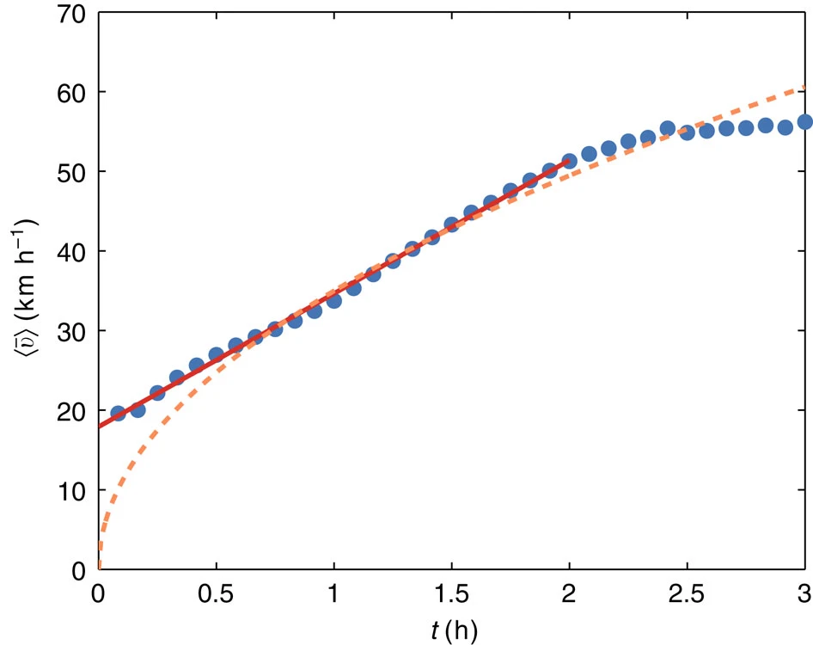
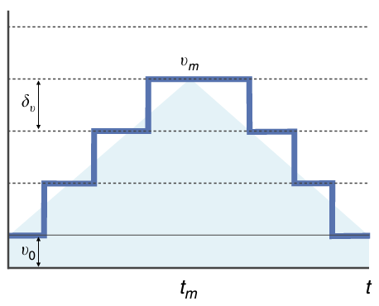

Scaling in mobility
Scaling from random fluctuations on speed.
Gallotti, Riccardo, et al. "A stochastic model of randomly accelerated walkers for human mobility." Nature communications 7.1 (2016): 12600.

Slide 40

Scaling in mobility
The nonlinear scaling is due to the topological structure of street networks.
Maia, Gabriel, et al. "A global empirical study on how street networks facilitate driving longer distances." Scientific reports 13.1 (2023): 18154.

Slide 41

Maia, Gabriel, et al. "A global empirical study on how street networks facilitate driving longer distances." Scientific reports 13.1 (2023): 18154.

Slide 42
What about accessibility?

Slide 43




Optimal distribution of facilities
Michael T. Gastner, and Mark EJ Newman. "Optimal design of spatial distribution networks." Physical Review E 74.1 (2006): 016117.

Slide 44


Ambulatory hospitals in the US.
Public schools in the US.
Um, Jaegon, et al. "Scaling laws between population and facility densities." Proceedings of the National Academy of Sciences 106.34 (2009): 14236-14240.

Slide 45


Slide 47






Melo, Hygor Piaget M., et al. "Statistical signs of social influence on suicides." Scientific Reports 4.1 (2014): 1-6.
Caminha C, Furtado V, Pequeno THC, Ponte C, Melo HPM, et al. (2017) Human mobility in large cities as a proxy for crime. PLOS ONE 12(2): e0171609.
Melo, Hygor Piaget M, et al. "Heterogeneous impact of a lockdown on inter-municipality mobility." Physical Review Research 3.1 (2021): 013032.
Maia, Gabriel, et al. “A global empirical study on how street networks facilitate driving longer distances.” Scientific reports 13.1 (2023): 18154.
@HygorPiaget
José S. Andrade Jr.
Saulo Reis
Hernan Makse

Slide 48




Melo, Hygor Piaget M., et al. "Statistical signs of social influence on suicides." Scientific Reports 4.1 (2014): 1-6.
Caminha C, Furtado V, Pequeno THC, Ponte C, Melo HPM, et al. (2017) Human mobility in large cities as a proxy for crime. PLOS ONE 12(2): e0171609.
Melo, Hygor Piaget M, et al. "Heterogeneous impact of a lockdown on inter-municipality mobility." Physical Review Research 3.1 (2021): 013032.
Maia, Gabriel, et al. “A global empirical study on how street networks facilitate driving longer distances.” Scientific reports 13.1 (2023): 18154.
@HygorPiaget
Carlos Caminha
Caio Ponte
Vasco Furtado

Slide 49




Melo, Hygor Piaget M., et al. "Statistical signs of social influence on suicides." Scientific Reports 4.1 (2014): 1-6.
Caminha C, Furtado V, Pequeno THC, Ponte C, Melo HPM, et al. (2017) Human mobility in large cities as a proxy for crime. PLOS ONE 12(2): e0171609.
Melo, Hygor Piaget M, et al. "Heterogeneous impact of a lockdown on inter-municipality mobility." Physical Review Research 3.1 (2021): 013032.
Maia, Gabriel, et al. “A global empirical study on how street networks facilitate driving longer distances.” Scientific reports 13.1 (2023): 18154.
@HygorPiaget
Nuno Araújo
Trivik Verma

Slide 50




Melo, Hygor Piaget M., et al. "Statistical signs of social influence on suicides." Scientific Reports 4.1 (2014): 1-6.
Caminha C, Furtado V, Pequeno THC, Ponte C, Melo HPM, et al. (2017) Human mobility in large cities as a proxy for crime. PLOS ONE 12(2): e0171609.
Melo, Hygor Piaget M, et al. "Heterogeneous impact of a lockdown on inter-municipality mobility." Physical Review Research 3.1 (2021): 013032.
Maia, Gabriel, et al. “A global empirical study on how street networks facilitate driving longer distances.” Scientific reports 13.1 (2023): 18154.
@HygorPiaget
Vittorio Loreto
Matteo Bruno

Slide 51


What still needs to be done?
"I first believed I was dreaming… But it is absolutely certain and exact that the ratio which exists between the period times of any two planets is precisely the ratio of the 3/2th power of the mean distance."
translated from Harmonies of the World by Kepler (1619)
The Key to Everything, Freeman Dyson

Slide 52


Origin of urban scaling laws
Ribeiro, Fabiano L., and Diego Rybski. "Mathematical models to explain the origin of urban scaling laws." Physics Reports 1012 (2023): 1-39.

Slide 53


